Slide 1
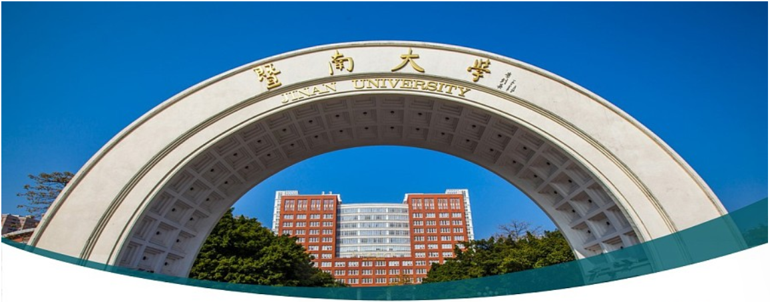

Machine Learning 10. Convolutional Neural Networks
Xueyuan Gong
School of Intelligent Systems Science and Engineering

Slide 2
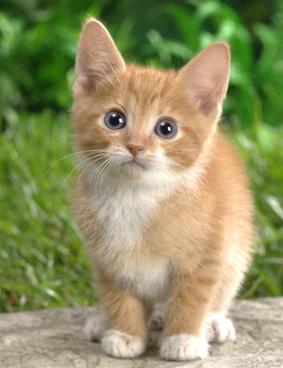

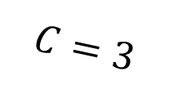
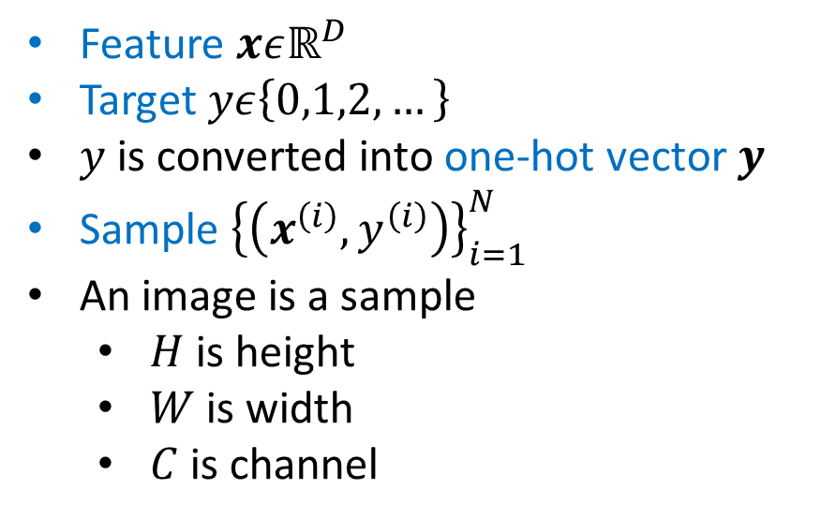

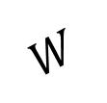
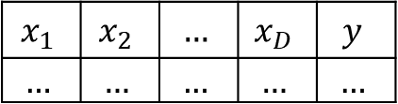

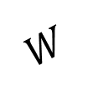



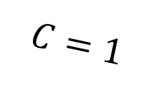
Multi-class classification
$$C=3$$
$$H$$
$$D=$$
$$H×W×3$$
Dataset
$$x_{1}$$ | $$x_{2}$$ | $$…$$ | $$x_{D}$$ | $$y$$
$$…$$ | $$…$$ | $$…$$ | $$…$$ | $$…$$
$$W$$
Feature $xεℝ^{D}$
Target $yε\left\{0,1,2,…\right\}$
$y$ is converted into one-hot vector $y$
Sample ${\left\{\left(x^{\left(i\right)},y^{\left(i\right)}\right)\right\}}_{i=1}^{N}$
An image is a sample
$H$ is height
$W$ is width
$C$ is channel
$$C=1$$
$$H$$
$$D=$$
$$H×W×1$$
$$W$$

Slide 3


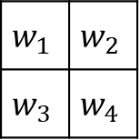
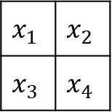
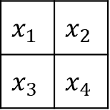
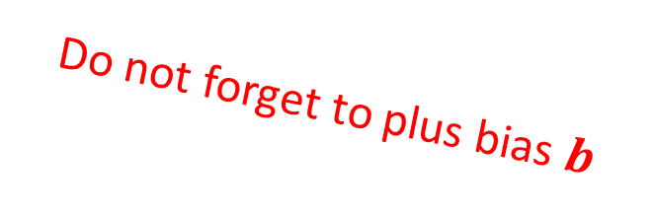
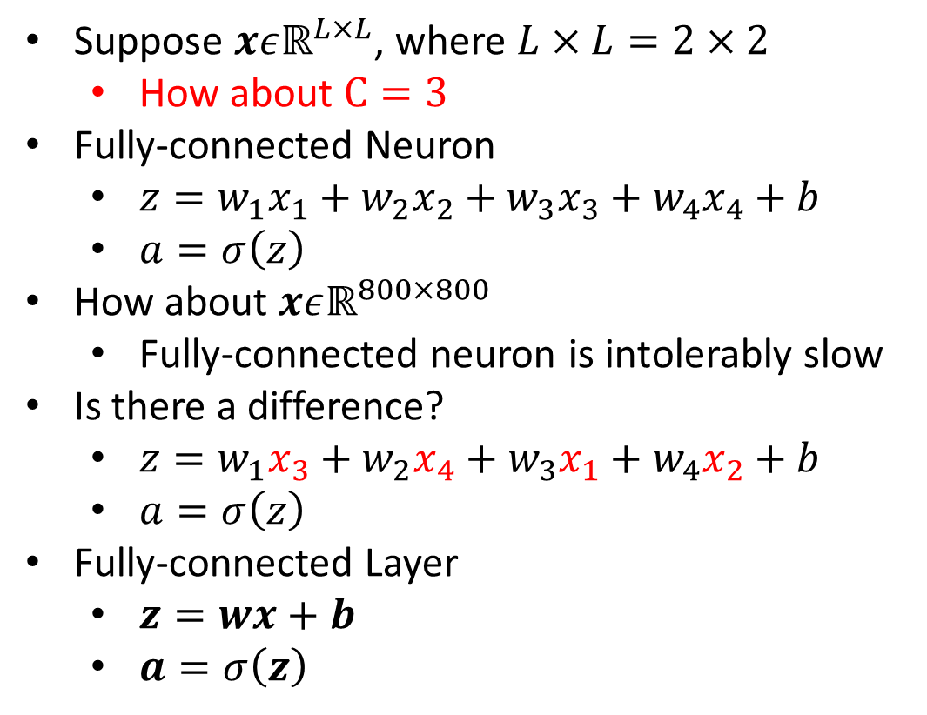



Fully Connected Layer
Suppose $xεℝ^{L×L}$, where $L×L=2×2$
How about $C=3$
Fully-connected Neuron
$z=w_{1}x_{1}+w_{2}x_{2}+w_{3}x_{3}+w_{4}x_{4}+b$
$a=σ\left(z\right)$
How about $xεℝ^{800×800}$
Fully-connected neuron is intolerably slow
Is there a difference?
$z=w_{1}x_{3}+w_{2}x_{4}+w_{3}x_{1}+w_{4}x_{2}+b$
$a=σ\left(z\right)$
Fully-connected Layer
$z=wx+b$
$a=σ\left(z\right)$
$$x_{1}$$
$$x_{2}$$
$$x_{3}$$
$$x_{4}$$
$$x_{1}$$ | $$x_{2}$$
$$x_{3}$$ | $$x_{4}$$
$$z$$ | a
Fully-connected point of view
Do not forget to plus bias $b$
$$x_{1}$$ | $$x_{2}$$
$$x_{3}$$ | $$x_{4}$$
$$w_{1}$$ | $$w_{2}$$
$$w_{3}$$ | $$w_{4}$$
$$∗$$
$$=$$
$$z$$ | a
Convolutional point of view

Slide 4








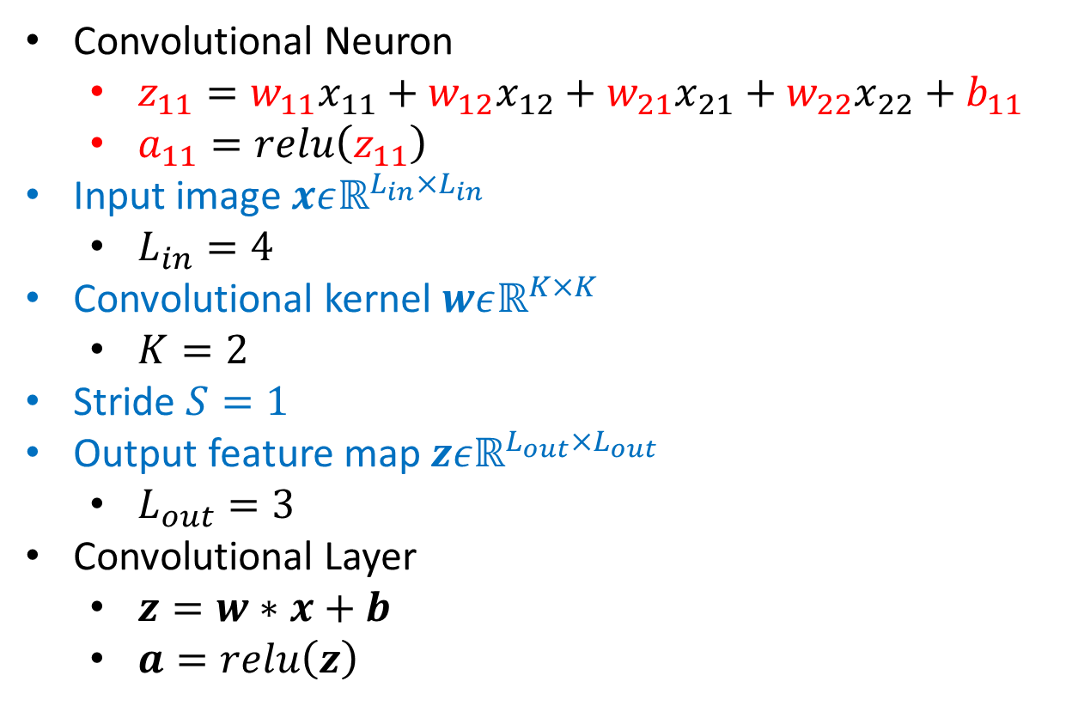



Convolutional Layer
$$x_{11}$$ | $$x_{12}$$ | $$x_{13}$$ | $$x_{14}$$
$$x_{21}$$ | $$x_{22}$$ | $$x_{23}$$ | $$x_{24}$$
$$x_{31}$$ | $$x_{32}$$ | $$x_{33}$$ | $$x_{34}$$
$$x_{41}$$ | $$x_{42}$$ | $$x_{43}$$ | $$x_{44}$$
$$z_{11}$$ | $$z_{12}$$ | $$z_{13}$$
$$z_{21}$$ | $$z_{22}$$ | $$z_{23}$$
$$z_{31}$$ | $$z_{32}$$ | $$z_{33}$$
$$w_{11}$$ | $$w_{12}$$
$$w_{21}$$ | $$w_{22}$$
$$∗$$
$$=$$
Convolutional Neuron
$z_{11}=w_{11}x_{11}+w_{12}x_{12}+w_{21}x_{21}+w_{22}x_{22}+b_{11}$
$a_{11}=relu\left(z_{11}\right)$
Input image $xεℝ^{L_{in}×L_{in}}$
$L_{in}=4$
Convolutional kernel $wεℝ^{K×K}$
$K=2$
Stride $S=1$
Output feature map $zεℝ^{L_{out}×L_{out}}$
$L_{out}=3$
Convolutional Layer
$z=w∗x+b$
$a=relu\left(z\right)$
Convolutional point of view
$$x_{11}$$
$$x_{12}$$
$$x_{13}$$
$$x_{14}$$
$$x_{21}$$
$$x_{22}$$
$$x_{23}$$
$$x_{24}$$
$$…$$
$$z_{11}$$
$$x_{11}$$ | $$x_{12}$$ | $$x_{13}$$ | $$x_{14}$$
$$x_{21}$$ | $$x_{22}$$ | $$x_{23}$$ | $$x_{24}$$
$$x_{31}$$ | $$x_{32}$$ | $$x_{33}$$ | $$x_{34}$$
$$x_{41}$$ | $$x_{42}$$ | $$x_{43}$$ | $$x_{44}$$
$$z_{12}$$
$$z_{13}$$
$$…$$
Fully-connected point of view

Slide 5

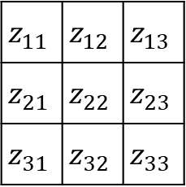

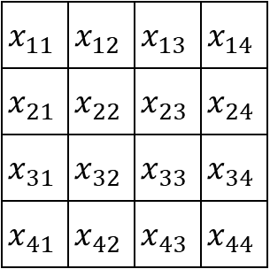

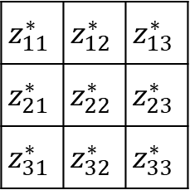

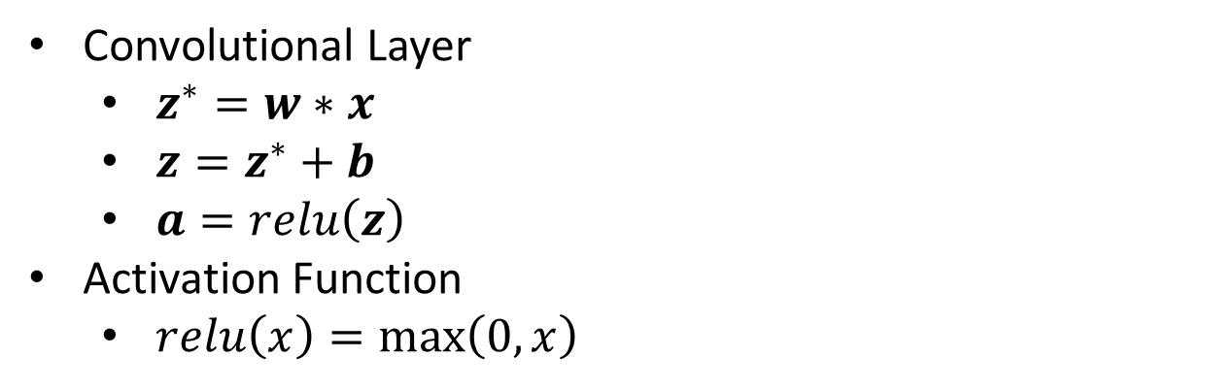
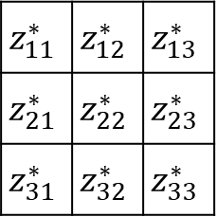


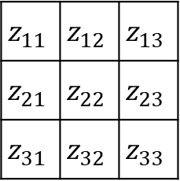

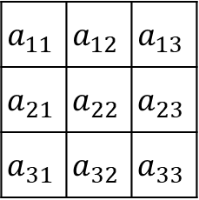


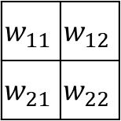
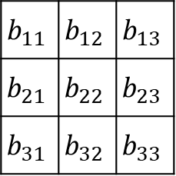

Convolutional Layer
$$L_{in}=4$$
$$K=2$$
$$L_{out}=3$$
$$S=1$$
$$x_{11}$$ | $$x_{12}$$ | $$x_{13}$$ | $$x_{14}$$
$$x_{21}$$ | $$x_{22}$$ | $$x_{23}$$ | $$x_{24}$$
$$x_{31}$$ | $$x_{32}$$ | $$x_{33}$$ | $$x_{34}$$
$$x_{41}$$ | $$x_{42}$$ | $$x_{43}$$ | $$x_{44}$$
$$z_{11}^{∗}$$ | $$z_{12}^{∗}$$ | $$z_{13}^{∗}$$
$$z_{21}^{∗}$$ | $$z_{22}^{∗}$$ | $$z_{23}^{∗}$$
$$z_{31}^{∗}$$ | $$z_{32}^{∗}$$ | $$z_{33}^{∗}$$
Convolutional Layer
$z^{∗}=w∗x$
$z=z^{∗}+b$
$a=relu\left(z\right)$
Activation Function
$relu\left(x\right)=\max\left(0,x\right)$
$$w_{11}$$ | $$w_{12}$$
$$w_{21}$$ | $$w_{22}$$
$$∗$$
$$=$$
$$z_{11}^{∗}$$ | $$z_{12}^{∗}$$ | $$z_{13}^{∗}$$
$$z_{21}^{∗}$$ | $$z_{22}^{∗}$$ | $$z_{23}^{∗}$$
$$z_{31}^{∗}$$ | $$z_{32}^{∗}$$ | $$z_{33}^{∗}$$
$$b_{11}$$ | $$b_{12}$$ | $$b_{13}$$
$$b_{21}$$ | $$b_{22}$$ | $$b_{23}$$
$$b_{31}$$ | $$b_{32}$$ | $$b_{33}$$
$$z_{11}$$ | $$z_{12}$$ | $$z_{13}$$
$$z_{21}$$ | $$z_{22}$$ | $$z_{23}$$
$$z_{31}$$ | $$z_{32}$$ | $$z_{33}$$
$$+$$
$$=$$
$$z_{11}$$ | $$z_{12}$$ | $$z_{13}$$
$$z_{21}$$ | $$z_{22}$$ | $$z_{23}$$
$$z_{31}$$ | $$z_{32}$$ | $$z_{33}$$
$$a_{11}$$ | $$a_{12}$$ | $$a_{13}$$
$$a_{21}$$ | $$a_{22}$$ | $$a_{23}$$
$$a_{31}$$ | $$a_{32}$$ | $$a_{33}$$
$$relu\left( \right)$$
$$=$$

Slide 6



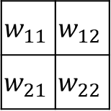
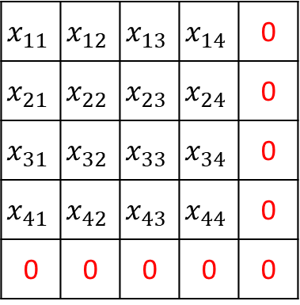

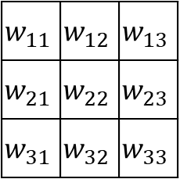

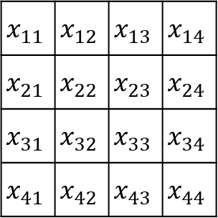

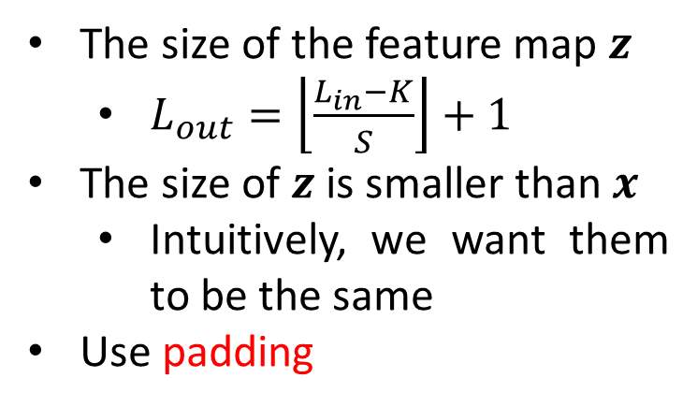
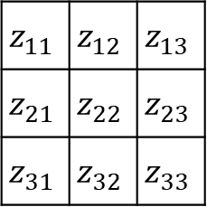
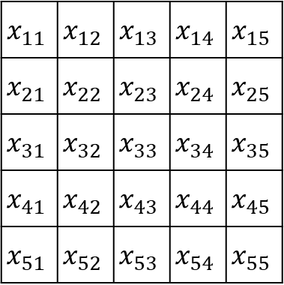

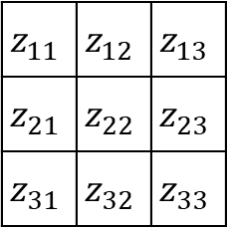





Padding
$$L_{in}=4$$
$$K=2$$
$$L_{out}=3$$
$$S=1$$
$$x_{11}$$ | $$x_{12}$$ | $$x_{13}$$ | $$x_{14}$$
$$x_{21}$$ | $$x_{22}$$ | $$x_{23}$$ | $$x_{24}$$
$$x_{31}$$ | $$x_{32}$$ | $$x_{33}$$ | $$x_{34}$$
$$x_{41}$$ | $$x_{42}$$ | $$x_{43}$$ | $$x_{44}$$
The size of the feature map $z$
$L_{out}=\left\lfloor \frac{L_{in}−K}{S}\right\rfloor +1$
The size of $z$ is smaller than $x$
Intuitively, we want them to be the same
Use padding
$$z_{11}$$ | $$z_{12}$$ | $$z_{13}$$
$$z_{21}$$ | $$z_{22}$$ | $$z_{23}$$
$$z_{31}$$ | $$z_{32}$$ | $$z_{33}$$
$$w_{11}$$ | $$w_{12}$$
$$w_{21}$$ | $$w_{22}$$
$$∗$$
$$=$$
$$L_{in}=5$$
$$K=3$$
$$L_{out}=3$$
$$S=1$$
$$x_{11}$$ | $$x_{12}$$ | $$x_{13}$$ | $$x_{14}$$ | 0
$$x_{21}$$ | $$x_{22}$$ | $$x_{23}$$ | $$x_{24}$$ | 0
$$x_{31}$$ | $$x_{32}$$ | $$x_{33}$$ | $$x_{34}$$ | 0
$$x_{41}$$ | $$x_{42}$$ | $$x_{43}$$ | $$x_{44}$$ | 0
0 | 0 | 0 | 0 | 0
$$x_{11}$$ | $$x_{12}$$ | $$x_{13}$$ | $$x_{14}$$ | $$x_{15}$$
$$x_{21}$$ | $$x_{22}$$ | $$x_{23}$$ | $$x_{24}$$ | $$x_{25}$$
$$x_{31}$$ | $$x_{32}$$ | $$x_{33}$$ | $$x_{34}$$ | $$x_{35}$$
$$x_{41}$$ | $$x_{42}$$ | $$x_{43}$$ | $$x_{44}$$ | $$x_{45}$$
$$x_{51}$$ | $$x_{52}$$ | $$x_{53}$$ | $$x_{54}$$ | $$x_{55}$$
$$w_{11}$$ | $$w_{12}$$ | $$w_{13}$$
$$w_{21}$$ | $$w_{22}$$ | $$w_{23}$$
$$w_{31}$$ | $$w_{32}$$ | $$w_{33}$$
$$z_{11}$$ | $$z_{12}$$ | $$z_{13}$$
$$z_{21}$$ | $$z_{22}$$ | $$z_{23}$$
$$z_{31}$$ | $$z_{32}$$ | $$z_{33}$$
$$∗$$
$$=$$

Slide 7


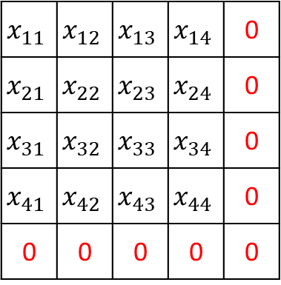




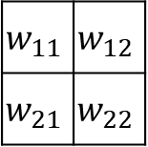

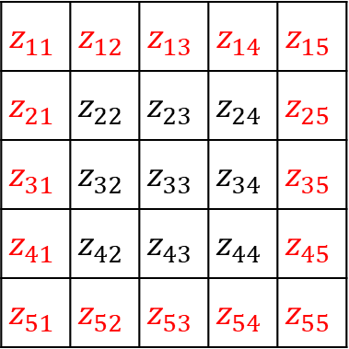

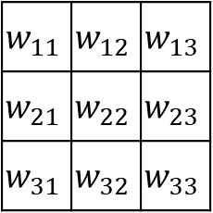
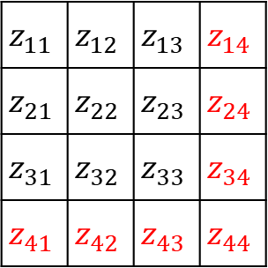

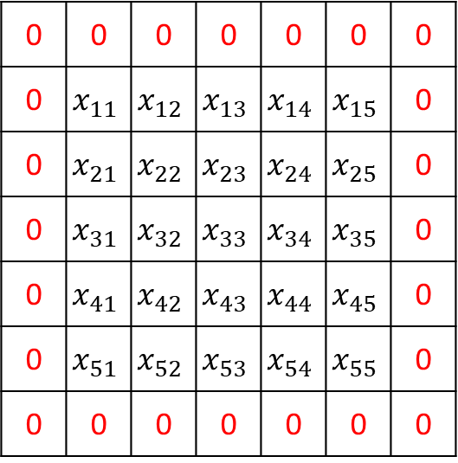
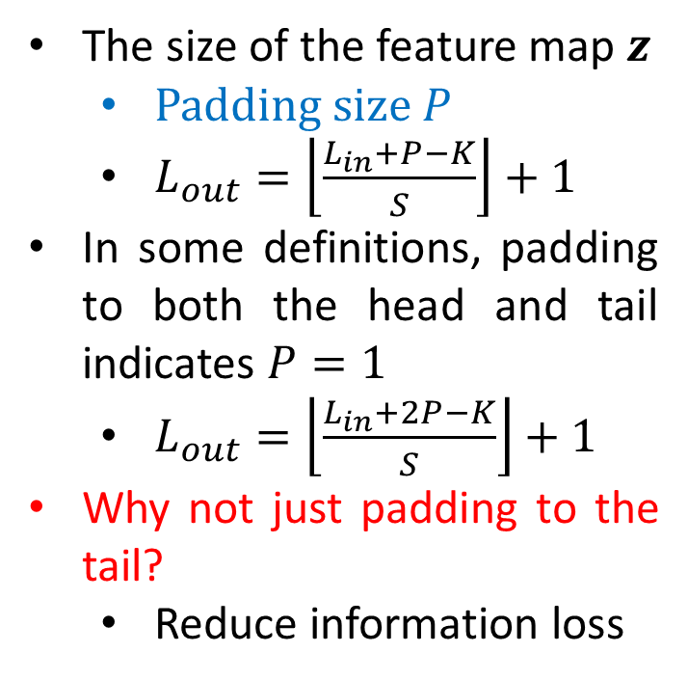



Padding
$$L_{out}=4$$
$$L_{in}=4+1$$
$$K=2$$
$$S=1$$
$$x_{11}$$ | $$x_{12}$$ | $$x_{13}$$ | $$x_{14}$$ | 0
$$x_{21}$$ | $$x_{22}$$ | $$x_{23}$$ | $$x_{24}$$ | 0
$$x_{31}$$ | $$x_{32}$$ | $$x_{33}$$ | $$x_{34}$$ | 0
$$x_{41}$$ | $$x_{42}$$ | $$x_{43}$$ | $$x_{44}$$ | 0
0 | 0 | 0 | 0 | 0
$$z_{11}$$ | $$z_{12}$$ | $$z_{13}$$ | $$z_{14}$$
$$z_{21}$$ | $$z_{22}$$ | $$z_{23}$$ | $$z_{24}$$
$$z_{31}$$ | $$z_{32}$$ | $$z_{33}$$ | $$z_{34}$$
$$z_{41}$$ | $$z_{42}$$ | $$z_{43}$$ | $$z_{44}$$
$$w_{11}$$ | $$w_{12}$$
$$w_{21}$$ | $$w_{22}$$
$$=$$
$$∗$$
The size of the feature map $z$
Padding size $P$
$L_{out}=\left\lfloor \frac{L_{in}+P−K}{S}\right\rfloor +1$
In some definitions, padding to both the head and tail indicates $P=1$
$L_{out}=\left\lfloor \frac{L_{in}+2P−K}{S}\right\rfloor +1$
Why not just padding to the tail?
Reduce information loss
$$L_{out}=5$$
$$L_{in}=5+2$$
$$K=3$$
$$S=1$$
0 | 0 | 0 | 0 | 0 | 0 | 0
0 | $$x_{11}$$ | $$x_{12}$$ | $$x_{13}$$ | $$x_{14}$$ | $$x_{15}$$ | 0
0 | $$x_{21}$$ | $$x_{22}$$ | $$x_{23}$$ | $$x_{24}$$ | $$x_{25}$$ | 0
0 | $$x_{31}$$ | $$x_{32}$$ | $$x_{33}$$ | $$x_{34}$$ | $$x_{35}$$ | 0
0 | $$x_{41}$$ | $$x_{42}$$ | $$x_{43}$$ | $$x_{44}$$ | $$x_{45}$$ | 0
0 | $$x_{51}$$ | $$x_{52}$$ | $$x_{53}$$ | $$x_{54}$$ | $$x_{55}$$ | 0
0 | 0 | 0 | 0 | 0 | 0 | 0
$$z_{11}$$ | $$z_{12}$$ | $$z_{13}$$ | $$z_{14}$$ | $$z_{15}$$
$$z_{21}$$ | $$z_{22}$$ | $$z_{23}$$ | $$z_{24}$$ | $$z_{25}$$
$$z_{31}$$ | $$z_{32}$$ | $$z_{33}$$ | $$z_{34}$$ | $$z_{35}$$
$$z_{41}$$ | $$z_{42}$$ | $$z_{43}$$ | $$z_{44}$$ | $$z_{45}$$
$$z_{51}$$ | $$z_{52}$$ | $$z_{53}$$ | $$z_{54}$$ | $$z_{55}$$
$$w_{11}$$ | $$w_{12}$$ | $$w_{13}$$
$$w_{21}$$ | $$w_{22}$$ | $$w_{23}$$
$$w_{31}$$ | $$w_{32}$$ | $$w_{33}$$
$$=$$
$$∗$$

Slide 8



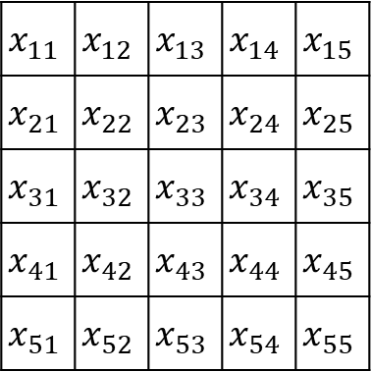

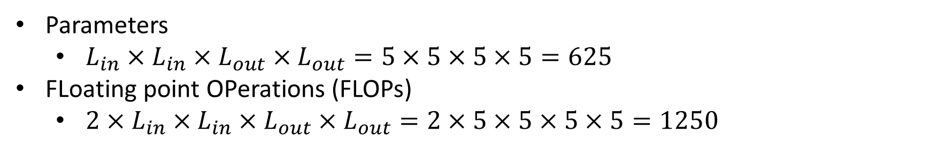


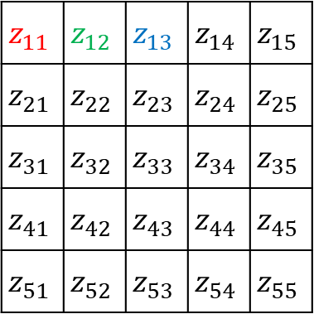

Parameters and FLOPs
Parameters
$L_{in}×L_{in}×L_{out}×L_{out}=5×5×5×5=625$
FLoating point OPerations (FLOPs)
$2×L_{in}×L_{in}×L_{out}×L_{out}=2×5×5×5×5=1250$
$$…$$
$$w_{3}$$
$$…$$
$$w_{2}$$
$$w_{1}$$
$$x_{11}$$ | $$x_{12}$$ | $$x_{13}$$ | $$x_{14}$$ | $$x_{15}$$
$$x_{21}$$ | $$x_{22}$$ | $$x_{23}$$ | $$x_{24}$$ | $$x_{25}$$
$$x_{31}$$ | $$x_{32}$$ | $$x_{33}$$ | $$x_{34}$$ | $$x_{35}$$
$$x_{41}$$ | $$x_{42}$$ | $$x_{43}$$ | $$x_{44}$$ | $$x_{45}$$
$$x_{51}$$ | $$x_{52}$$ | $$x_{53}$$ | $$x_{54}$$ | $$x_{55}$$
$$z_{11}$$ | $$z_{12}$$ | $$z_{13}$$ | $$z_{14}$$ | $$z_{15}$$
$$z_{21}$$ | $$z_{22}$$ | $$z_{23}$$ | $$z_{24}$$ | $$z_{25}$$
$$z_{31}$$ | $$z_{32}$$ | $$z_{33}$$ | $$z_{34}$$ | $$z_{35}$$
$$z_{41}$$ | $$z_{42}$$ | $$z_{43}$$ | $$z_{44}$$ | $$z_{45}$$
$$z_{51}$$ | $$z_{52}$$ | $$z_{53}$$ | $$z_{54}$$ | $$z_{55}$$
$$∗$$
$$=$$
Fully-connected layer

Slide 9
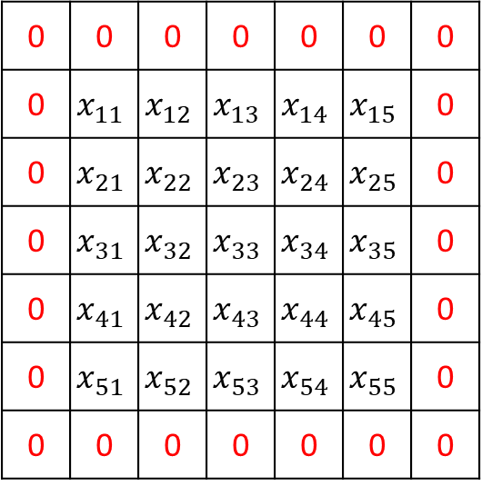
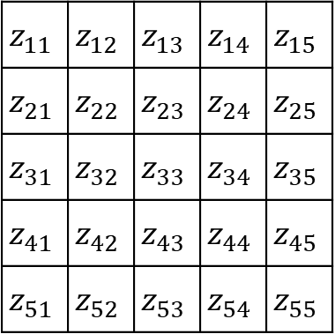
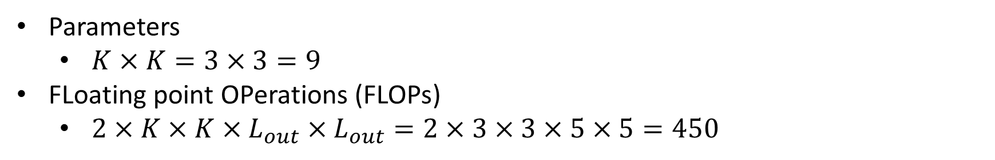


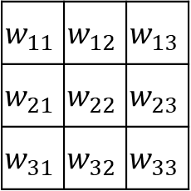
Parameters and FLOPs
Parameters
$K×K=3×3=9$
FLoating point OPerations (FLOPs)
$2×K×K×L_{out}×L_{out}=2×3×3×5×5=450$
0 | 0 | 0 | 0 | 0 | 0 | 0
0 | $$x_{11}$$ | $$x_{12}$$ | $$x_{13}$$ | $$x_{14}$$ | $$x_{15}$$ | 0
0 | $$x_{21}$$ | $$x_{22}$$ | $$x_{23}$$ | $$x_{24}$$ | $$x_{25}$$ | 0
0 | $$x_{31}$$ | $$x_{32}$$ | $$x_{33}$$ | $$x_{34}$$ | $$x_{35}$$ | 0
0 | $$x_{41}$$ | $$x_{42}$$ | $$x_{43}$$ | $$x_{44}$$ | $$x_{45}$$ | 0
0 | $$x_{51}$$ | $$x_{52}$$ | $$x_{53}$$ | $$x_{54}$$ | $$x_{55}$$ | 0
0 | 0 | 0 | 0 | 0 | 0 | 0
$$z_{11}$$ | $$z_{12}$$ | $$z_{13}$$ | $$z_{14}$$ | $$z_{15}$$
$$z_{21}$$ | $$z_{22}$$ | $$z_{23}$$ | $$z_{24}$$ | $$z_{25}$$
$$z_{31}$$ | $$z_{32}$$ | $$z_{33}$$ | $$z_{34}$$ | $$z_{35}$$
$$z_{41}$$ | $$z_{42}$$ | $$z_{43}$$ | $$z_{44}$$ | $$z_{45}$$
$$z_{51}$$ | $$z_{52}$$ | $$z_{53}$$ | $$z_{54}$$ | $$z_{55}$$
$$w_{11}$$ | $$w_{12}$$ | $$w_{13}$$
$$w_{21}$$ | $$w_{22}$$ | $$w_{23}$$
$$w_{31}$$ | $$w_{32}$$ | $$w_{33}$$
$$∗$$
$$=$$
Convolutional layer

Slide 10
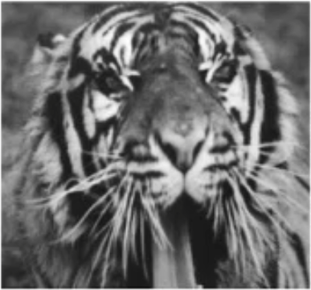





Convolutional Kernel
Prewitt kernel
Edge detection
Convolved by
$$w_{1}=\left[\begin{matrix}−1 & 0 & 1 \\ −1 & 0 & 1 \\ −1 & 0 & 1\end{matrix}\right]$$
Convolved by
$$w_{2}=\left[\begin{matrix}−1 & −1 & −1 \\ 0 & 0 & 0 \\ 1 & 1 & 1\end{matrix}\right]$$
Original image
Final result

Slide 11

Convolutional Kernel
Given a binary image classification example
All features are normalized to $x_{i}ε\left[−1,1\right]$
-1 means black color and 1 means white color
Translation
Scaling
Rotation
Weight
Convolutional
Kernels

Slide 12









Convolutional Kernel
$$∗$$
$$=$$
What we ignore at the moment
Channel $C$
Bias $b$
Convolutions are able to extract features
$$∗$$
$$=$$
$$∗$$
$$=$$

Slide 13




Activation Function
Relu function
$a=relu\left(z\right)=\max\left(0,z\right)$
Give the model nonlinearity
Ignore neurons that do not have any feature

Slide 14














Pooling Layer
$$x_{11}$$ | $$x_{12}$$ | $$x_{13}$$ | $$x_{14}$$
$$x_{21}$$ | $$x_{22}$$ | $$x_{23}$$ | $$x_{24}$$
$$x_{31}$$ | $$x_{32}$$ | $$x_{33}$$ | $$x_{34}$$
$$x_{41}$$ | $$x_{42}$$ | $$x_{43}$$ | $$x_{44}$$
$$max\left(x_{11},x_{12},x_{21},x_{22}\right)$$ | $$max\left(x_{13},x_{14},x_{23},x_{24}\right)$$
$$max\left(x_{31},x_{32},x_{41},x_{42}\right)$$ | $$max\left(x_{33},x_{34},x_{43},x_{44}\right)$$
Pooling kernel can be regarded as a kind of special convolutional kernel
$L_{out}=\left\lfloor \frac{L_{in}+P−K}{S}\right\rfloor +1$
Max pooling
$$L_{in}=4$$
$$K=2$$
$$L_{out}=2$$
$$P=0$$
$$S=2$$
$$x_{11}$$ | $$x_{12}$$ | $$x_{13}$$ | $$x_{14}$$
$$x_{21}$$ | $$x_{22}$$ | $$x_{23}$$ | $$x_{24}$$
$$x_{31}$$ | $$x_{32}$$ | $$x_{33}$$ | $$x_{34}$$
$$x_{41}$$ | $$x_{42}$$ | $$x_{43}$$ | $$x_{44}$$
$$\frac{x_{11}+x_{12}+x_{21}+x_{22}}{4}$$ | $$\frac{x_{13}+x_{14}+x_{23}+x_{24}}{4}$$
$$\frac{x_{31}+x_{32}+x_{41}+x_{42}}{4}$$ | $$\frac{x_{33}+x_{34}+x_{43}+x_{44}}{4}$$
$$x_{11}$$ | $$x_{12}$$ | $$x_{13}$$ | $$x_{14}$$
$$x_{21}$$ | $$x_{22}$$ | $$x_{23}$$ | $$x_{24}$$
$$x_{31}$$ | $$x_{32}$$ | $$x_{33}$$ | $$x_{34}$$
$$x_{41}$$ | $$x_{42}$$ | $$x_{43}$$ | $$x_{44}$$
$$z_{11}$$ | $$z_{12}$$
$$z_{21}$$ | $$z_{22}$$
$$∗$$
$$=$$
Average pooling

Slide 15



Pooling Kernel
Truncate ignored neurons and less important neurons
Accelerate computational speed
Reduce parameters

Slide 16
















Another Convolutional and Pooling Layer
Pooling
$$∗$$
$$+$$
$$=$$
$$L_{in}=4$$
$$K=2$$
$$C_{in}=3$$
$$L_{out}=3$$
$$L_{out}=3$$
$$C_{in}=3$$
$$S=1$$
$$C_{out}=3$$
$$C_{out}=3$$
$$C_{out}=3$$

Slide 17


Convolutional Neural Networks
The last layer is a fully-connected layer
This is a simple version of LeNet
Neural networks can be regarded as
Feature extractor
Convolution
Relu
Convolution
Pooling
Relu
Pooling
$$z$$ | a

Slide 18



Cost Function
Loss Function
$$ℒ\left(W,B\right)=−\sum_{i=1}^{C}{y_{i}\log{{\hat{y}}_{i}}}=−y^{T}\log{\hat{y}}$$
Cost Function
$$𝒥\left(W,B\right)=−\frac{1}{N}\sum_{i=1}^{N}{\sum_{j=1}^{C}{y_{j}^{\left(i\right)}\log{{\hat{y}}_{j}^{\left(i\right)}}}}=−\frac{1}{N}\sum_{i=1}^{N}{{\left(y^{\left(i\right)}\right)}^{T}\log{{\hat{y}}^{\left(i\right)}}}$$
$ℒ\left(W,B\right)$ is the same as the loss function of Softmax regression
Cross entropy
Cross entropy is equivalent to binary cross entropy

Slide 19


Back Propagation
Forward
$$ℒ=−y^{T}\log{\hat{y}}$$
Backward
$$\frac{∂ℒ}{∂{\hat{y}}_{m}}=−\frac{y_{m}}{{\hat{y}}_{m}}$$

Slide 20


Back Propagation
Forward
$$\hat{y}=a=softmax\left(z\right)$$
Backward
$$\frac{∂a_{n}}{∂z_{m}}=\left\{\begin{aligned}a_{m}\left(1−a_{m}\right), n=m \\ −a_{n}a_{m},n≠m\end{aligned}\right.$$

Slide 21






Back Propagation
Forward
Forward
$$ℒ=−y^{T}\log{\hat{y}}$$
$$ℒ=−y^{T}\log\left[softmax\left(z\right)\right]$$
$$\hat{y}=a=softmax\left(z\right)$$
Backward
Backward
$$\frac{∂ℒ}{∂{\hat{y}}_{m}}=−\frac{y_{m}}{{\hat{y}}_{m}}$$
$$\frac{∂ℒ}{∂z_{m}}=\sum_{i=1}^{D^{\left[L\right]}}{\frac{∂ℒ}{∂a_{i}}\frac{∂a_{i}}{∂z_{m}}}=a_{m}−y_{m}$$
$$\frac{∂a_{n}}{∂z_{m}}=\left\{\begin{aligned}a_{m}\left(1−a_{m}\right), n=m \\ −a_{n}a_{m},n≠m\end{aligned}\right.$$

Slide 22







Back Propagation
Forward
Gradient
$$\frac{∂z_{n}}{∂w_{mn}}=x_{m}$$
$$z={\left(w\right)}^{T}x+b$$
Backward
$$\frac{∂z_{n}}{∂b_{n}}=1$$
$$\frac{∂z_{n}}{∂x_{m}}=w_{mn}$$
$$\frac{∂ℒ}{∂w_{mn}}=\frac{∂ℒ}{∂z_{n}}\frac{∂z_{n}}{∂w_{mn}}=\frac{∂ℒ}{∂z_{n}}x_{m}$$
$$\frac{∂ℒ}{∂x_{m}}=\frac{∂ℒ}{∂z_{n}}w_{mn}$$
$$\frac{∂ℒ}{∂b_{n}}=\frac{∂ℒ}{∂z_{n}}\frac{∂z_{n}}{∂b_{n}}=\frac{∂ℒ}{∂z_{n}}$$

Slide 23














Back Propagation
Forward
$$x_{11}$$ | $$x_{12}$$ | $$x_{13}$$ | $$x_{14}$$
$$x_{21}$$ | $$x_{22}$$ | $$x_{23}$$ | $$x_{24}$$
$$x_{31}$$ | $$x_{32}$$ | $$x_{33}$$ | $$x_{34}$$
$$x_{41}$$ | $$x_{42}$$ | $$x_{43}$$ | $$x_{44}$$
$$z_{11}=max\left(x_{11},x_{12},x_{21},x_{22}\right)=x_{11}$$
$$z_{12}=max\left(x_{13},x_{14},x_{23},x_{24}\right)=x_{23}$$
$$z_{21}=max\left(x_{31},x_{32},x_{41},x_{42}\right)=x_{32}$$
$$z_{22}=max\left(x_{33},x_{34},x_{43},x_{44}\right)=x_{44}$$
$$1$$ | $$0$$ | $$0$$ | $$0$$
$$0$$ | $$0$$ | $$1$$ | $$0$$
$$0$$ | $$1$$ | $$0$$ | $$0$$
$$0$$ | $$0$$ | $$0$$ | $$1$$
Backward
$$\frac{∂z_{11}}{∂x_{11}}=1$$
$$\frac{∂z_{12}}{∂x_{23}}=1$$
$$\frac{∂z_{21}}{∂x_{32}}=1$$
$$\frac{∂z_{22}}{∂x_{44}}=1$$
$$\frac{∂ℒ}{∂z_{11}}$$ | $$\frac{∂ℒ}{∂z_{23}}$$
$$\frac{∂ℒ}{∂z_{32}}$$ | $$\frac{∂ℒ}{∂z_{44}}$$
$$z_{11}$$ | $$z_{12}$$
$$z_{21}$$ | $$z_{22}$$
$$\frac{∂ℒ}{∂x_{11}}=\frac{∂ℒ}{∂z_{11}}$$
$$\frac{∂ℒ}{∂x_{23}}=\frac{∂ℒ}{∂z_{23}}$$
$$\frac{∂ℒ}{∂x_{32}}=\frac{∂ℒ}{∂z_{32}}$$
$$\frac{∂ℒ}{∂x_{44}}=\frac{∂ℒ}{∂z_{44}}$$
Otherwise $0$

Slide 24







Back Propagation
$$1$$ | $$1$$ | $$1$$ | $$0$$
$$1$$ | $$0$$ | $$1$$ | $$1$$
$$1$$ | $$1$$ | $$1$$ | $$0$$
$$0$$ | $$1$$ | $$0$$ | $$1$$
$$x_{11}$$ | $$x_{12}$$ | $$x_{13}$$ | $$x_{14}$$
$$x_{21}$$ | $$x_{22}$$ | $$x_{23}$$ | $$x_{24}$$
$$x_{31}$$ | $$x_{32}$$ | $$x_{33}$$ | $$x_{34}$$
$$x_{41}$$ | $$x_{42}$$ | $$x_{43}$$ | $$x_{44}$$
Forward
$$z=relu\left(x\right)=\max\left(0,x\right)$$
$$\frac{∂ℒ}{∂z_{11}}$$ | $$\frac{∂ℒ}{∂z_{12}}$$ | $$\frac{∂ℒ}{∂z_{13}}$$ | $$\frac{∂ℒ}{∂z_{14}}$$
$$\frac{∂ℒ}{∂z_{21}}$$ | $$\frac{∂ℒ}{∂z_{22}}$$ | $$\frac{∂ℒ}{∂z_{23}}$$ | $$\frac{∂ℒ}{∂z_{24}}$$
$$\frac{∂ℒ}{∂z_{31}}$$ | $$\frac{∂ℒ}{∂z_{32}}$$ | $$\frac{∂ℒ}{∂z_{33}}$$ | $$\frac{∂ℒ}{∂z_{34}}$$
$$\frac{∂ℒ}{∂z_{41}}$$ | $$\frac{∂ℒ}{∂z_{42}}$$ | $$\frac{∂ℒ}{∂z_{43}}$$ | $$\frac{∂ℒ}{∂z_{44}}$$
Backward
$$z_{11}$$ | $$z_{12}$$ | $$z_{13}$$ | $$0$$
$$z_{21}$$ | $$0$$ | $$z_{23}$$ | $$z_{24}$$
$$z_{31}$$ | $$z_{32}$$ | $$z_{33}$$ | $$0$$
$$0$$ | $$z_{42}$$ | $$0$$ | $$z_{44}$$
$$\frac{∂z_{mn}}{∂x_{mn}}=\left\{\begin{aligned}1,z_{mn}>0 \\ 0,z_{mn}=0\end{aligned}\right.$$
$$\frac{∂ℒ}{∂x_{mn}}=\left\{\begin{aligned}\frac{∂ℒ}{∂z_{mn}},z_{mn}>0 \\ 0,z_{mn}=0\end{aligned}\right.$$

Slide 25








Back Propagation
$$x_{11}$$ | $$x_{12}$$ | $$x_{13}$$ | $$x_{14}$$
$$x_{21}$$ | $$x_{22}$$ | $$x_{23}$$ | $$x_{24}$$
$$x_{31}$$ | $$x_{32}$$ | $$x_{33}$$ | $$x_{34}$$
$$x_{41}$$ | $$x_{42}$$ | $$x_{43}$$ | $$x_{44}$$
Forward
$$b_{11}$$ | $$b_{12}$$ | $$b_{13}$$
$$b_{21}$$ | $$b_{22}$$ | $$b_{23}$$
$$b_{31}$$ | $$b_{32}$$ | $$b_{33}$$
$$w_{11}$$ | $$w_{12}$$
$$w_{21}$$ | $$w_{22}$$
$$z=w∗x+b$$
$$∗$$
$$+$$
$$z_{11}=w_{11}x_{11}+w_{12}x_{12}+w_{21}x_{21}+w_{22}x_{22}+b_{11}$$
$$z_{12}=w_{11}x_{12}+w_{12}x_{13}+w_{21}x_{22}+w_{22}x_{23}+b_{12}$$
$$z_{13}=w_{11}x_{13}+w_{12}x_{14}+w_{21}x_{23}+w_{22}x_{24}+b_{13}$$
$$z_{21}=w_{11}x_{21}+w_{12}x_{22}+w_{21}x_{31}+w_{22}x_{32}+b_{21}$$
$$z_{22}=w_{11}x_{22}+w_{12}x_{23}+w_{21}x_{32}+w_{22}x_{33}+b_{22}$$
$$z_{23}=w_{11}x_{23}+w_{12}x_{24}+w_{21}x_{33}+w_{22}x_{34}+b_{23}$$
$$z_{31}=w_{11}x_{31}+w_{12}x_{32}+w_{21}x_{41}+w_{22}x_{42}+b_{31}$$
$$z_{32}=w_{11}x_{32}+w_{12}x_{33}+w_{21}x_{42}+w_{22}x_{43}+b_{32}$$
$$z_{33}=w_{11}x_{33}+w_{12}x_{34}+w_{21}x_{43}+w_{22}x_{44}+b_{33}$$
$$z_{11}$$ | $$z_{12}$$ | $$z_{13}$$
$$z_{21}$$ | $$z_{22}$$ | $$z_{23}$$
$$z_{31}$$ | $$z_{32}$$ | $$z_{33}$$

Slide 26





Back Propagation
Forward
Gradient
$$z_{11}=w_{11}x_{11}+w_{12}x_{12}+w_{21}x_{21}+w_{22}x_{22}+b_{11}$$
$$z_{12}=w_{11}x_{12}+w_{12}x_{13}+w_{21}x_{22}+w_{22}x_{23}+b_{12}$$
$$z_{13}=w_{11}x_{13}+w_{12}x_{14}+w_{21}x_{23}+w_{22}x_{24}+b_{13}$$
$$z_{21}=w_{11}x_{21}+w_{12}x_{22}+w_{21}x_{31}+w_{22}x_{32}+b_{21}$$
$$z_{22}=w_{11}x_{22}+w_{12}x_{23}+w_{21}x_{32}+w_{22}x_{33}+b_{22}$$
$$z_{23}=w_{11}x_{23}+w_{12}x_{24}+w_{21}x_{33}+w_{22}x_{34}+b_{23}$$
$$z_{31}=w_{11}x_{31}+w_{12}x_{32}+w_{21}x_{41}+w_{22}x_{42}+b_{31}$$
$$z_{32}=w_{11}x_{32}+w_{12}x_{33}+w_{21}x_{42}+w_{22}x_{43}+b_{32}$$
$$z_{33}=w_{11}x_{33}+w_{12}x_{34}+w_{21}x_{43}+w_{22}x_{44}+b_{33}$$
$$\frac{∂z_{mn}}{∂b_{mn}}=1$$
$$\frac{∂z_{ij}}{∂w_{mn}}=x_{uv}$$
$$\frac{∂ℒ}{∂b_{mn}}=\frac{∂ℒ}{∂z_{mn}}\frac{∂z_{mn}}{∂b_{mn}}=\frac{∂ℒ}{∂z_{mn}}$$
$$\frac{∂ℒ}{∂w_{mn}}=\sum_{i=1}^{L_{out}}{\sum_{j=1}^{L_{out}}{\frac{∂ℒ}{∂z_{ij}}\frac{∂z_{ij}}{∂w_{mn}}}}$$

Slide 27








Back Propagation
$$x_{11}$$ | $$x_{12}$$ | $$x_{13}$$ | $$x_{14}$$
$$x_{21}$$ | $$x_{22}$$ | $$x_{23}$$ | $$x_{24}$$
$$x_{31}$$ | $$x_{32}$$ | $$x_{33}$$ | $$x_{34}$$
$$x_{41}$$ | $$x_{42}$$ | $$x_{43}$$ | $$x_{44}$$
$$1$$ | $$1$$ | $$1$$
$$1$$ | $$1$$ | $$1$$
$$1$$ | $$1$$ | $$1$$
$$∗$$
$$+$$
Gradient
$$\frac{∂ℒ}{∂b_{mn}}=\frac{∂ℒ}{∂z_{mn}}\frac{∂z_{mn}}{∂b_{mn}}=\frac{∂ℒ}{∂z_{mn}}$$
$$\frac{∂ℒ}{∂z_{11}}$$ | $$\frac{∂ℒ}{∂z_{12}}$$ | $$\frac{∂ℒ}{∂z_{13}}$$
$$\frac{∂ℒ}{∂z_{21}}$$ | $$\frac{∂ℒ}{∂z_{22}}$$ | $$\frac{∂ℒ}{∂z_{23}}$$
$$\frac{∂ℒ}{∂z_{31}}$$ | $$\frac{∂ℒ}{∂z_{32}}$$ | $$\frac{∂ℒ}{∂z_{33}}$$
$$\frac{∂ℒ}{∂w_{mn}}=\sum_{i=1}^{L_{out}}{\sum_{j=1}^{L_{out}}{\frac{∂ℒ}{∂z_{ij}}\frac{∂z_{ij}}{∂w_{mn}}}}$$
$$\frac{∂ℒ}{∂w_{11}}=\frac{∂ℒ}{∂z_{11}}x_{11}+\frac{∂ℒ}{∂z_{12}}x_{12}+\frac{∂ℒ}{∂z_{13}}x_{13}+\frac{∂ℒ}{∂z_{21}}x_{21}+\frac{∂ℒ}{∂z_{22}}x_{22}+\frac{∂ℒ}{∂z_{23}}x_{23}+\frac{∂ℒ}{∂z_{31}}x_{31}+\frac{∂ℒ}{∂z_{32}}x_{32}+\frac{∂ℒ}{∂z_{33}}x_{33}$$
$$\frac{∂ℒ}{∂w_{12}}=\frac{∂ℒ}{∂z_{11}}x_{12}+\frac{∂ℒ}{∂z_{12}}x_{13}+\frac{∂ℒ}{∂z_{13}}x_{14}+\frac{∂ℒ}{∂z_{21}}x_{22}+\frac{∂ℒ}{∂z_{22}}x_{23}+\frac{∂ℒ}{∂z_{23}}x_{24}+\frac{∂ℒ}{∂z_{31}}x_{32}+\frac{∂ℒ}{∂z_{32}}x_{33}+\frac{∂ℒ}{∂z_{33}}x_{34}$$
$$\frac{∂ℒ}{∂w_{21}}=\frac{∂ℒ}{∂z_{11}}x_{21}+\frac{∂ℒ}{∂z_{12}}x_{22}+\frac{∂ℒ}{∂z_{13}}x_{23}+\frac{∂ℒ}{∂z_{21}}x_{31}+\frac{∂ℒ}{∂z_{22}}x_{32}+\frac{∂ℒ}{∂z_{23}}x_{33}+\frac{∂ℒ}{∂z_{31}}x_{41}+\frac{∂ℒ}{∂z_{32}}x_{42}+\frac{∂ℒ}{∂z_{33}}x_{43}$$
$$\frac{∂ℒ}{∂w_{22}}=\frac{∂ℒ}{∂z_{11}}x_{22}+\frac{∂ℒ}{∂z_{12}}x_{23}+\frac{∂ℒ}{∂z_{13}}x_{24}+\frac{∂ℒ}{∂z_{21}}x_{32}+\frac{∂ℒ}{∂z_{22}}x_{33}+\frac{∂ℒ}{∂z_{23}}x_{34}+\frac{∂ℒ}{∂z_{31}}x_{42}+\frac{∂ℒ}{∂z_{32}}x_{43}+\frac{∂ℒ}{∂z_{33}}x_{44}$$

Slide 28


Back Propagation
Forward
Backward
$$z_{11}=w_{11}x_{11}+w_{12}x_{12}+w_{21}x_{21}+w_{22}x_{22}+b_{11}$$
$$z_{12}=w_{11}x_{12}+w_{12}x_{13}+w_{21}x_{22}+w_{22}x_{23}+b_{12}$$
$$z_{13}=w_{11}x_{13}+w_{12}x_{14}+w_{21}x_{23}+w_{22}x_{24}+b_{13}$$
$$z_{21}=w_{11}x_{21}+w_{12}x_{22}+w_{21}x_{31}+w_{22}x_{32}+b_{21}$$
$$z_{22}=w_{11}x_{22}+w_{12}x_{23}+w_{21}x_{32}+w_{22}x_{33}+b_{22}$$
$$z_{23}=w_{11}x_{23}+w_{12}x_{24}+w_{21}x_{33}+w_{22}x_{34}+b_{23}$$
$$z_{31}=w_{11}x_{31}+w_{12}x_{32}+w_{21}x_{41}+w_{22}x_{42}+b_{31}$$
$$z_{32}=w_{11}x_{32}+w_{12}x_{33}+w_{21}x_{42}+w_{22}x_{43}+b_{32}$$
$$z_{33}=w_{11}x_{33}+w_{12}x_{34}+w_{21}x_{43}+w_{22}x_{44}+b_{33}$$
$$\frac{∂z_{ij}}{∂x_{uv}}=w_{mn}$$
$$\frac{∂ℒ}{∂x_{uv}}=\sum_{i=?}{\sum_{j=?}{\frac{∂ℒ}{∂z_{ij}}\frac{∂z_{ij}}{∂x_{uv}}}}$$

Slide 29





Back Propagation
$$\frac{∂ℒ}{∂z_{11}}$$ | $$\frac{∂ℒ}{∂z_{12}}$$ | $$\frac{∂ℒ}{∂z_{13}}$$
$$\frac{∂ℒ}{∂z_{21}}$$ | $$\frac{∂ℒ}{∂z_{22}}$$ | $$\frac{∂ℒ}{∂z_{23}}$$
$$\frac{∂ℒ}{∂z_{31}}$$ | $$\frac{∂ℒ}{∂z_{32}}$$ | $$\frac{∂ℒ}{∂z_{33}}$$
$$w_{11}$$ | $$w_{12}$$
$$w_{21}$$ | $$w_{22}$$
$$∗$$
Backward
$$\frac{∂ℒ}{∂x_{11}}= \frac{∂ℒ}{∂z_{11}}w_{11}$$
$$\frac{∂ℒ}{∂x_{12}}= \frac{∂ℒ}{∂z_{11}}w_{12}+\frac{∂ℒ}{∂z_{12}}w_{11}$$
$$\frac{∂ℒ}{∂x_{13}}= \frac{∂ℒ}{∂z_{12}}w_{12}+\frac{∂ℒ}{∂z_{13}}w_{11}$$
$$\frac{∂ℒ}{∂x_{14}}= \frac{∂ℒ}{∂z_{13}}w_{12}$$
$$\frac{∂ℒ}{∂x_{21}}= \frac{∂ℒ}{∂z_{11}}w_{21} +\frac{∂ℒ}{∂z_{21}}w_{11}$$
$$\frac{∂ℒ}{∂x_{22}}=\frac{∂ℒ}{∂z_{11}}w_{22}+\frac{∂ℒ}{∂z_{12}}w_{21}+\frac{∂ℒ}{∂z_{21}}w_{12}+\frac{∂ℒ}{∂z_{22}}w_{11}$$
$$\frac{∂ℒ}{∂x_{23}}=\frac{∂ℒ}{∂z_{12}}w_{22}+\frac{∂ℒ}{∂z_{13}}w_{21}+\frac{∂ℒ}{∂z_{22}}w_{12}+\frac{∂ℒ}{∂z_{23}}w_{11}$$
$$\frac{∂ℒ}{∂x_{24}}=\frac{∂ℒ}{∂z_{13}}w_{22} +\frac{∂ℒ}{∂z_{23}}w_{12}$$
$$\frac{∂ℒ}{∂x_{31}}= \frac{∂ℒ}{∂z_{21}}w_{21} +\frac{∂ℒ}{∂z_{31}}w_{11}$$
$$\frac{∂ℒ}{∂x_{32}}=\frac{∂ℒ}{∂z_{21}}w_{22}+\frac{∂ℒ}{∂z_{22}}w_{21}+\frac{∂ℒ}{∂z_{31}}w_{12}+\frac{∂ℒ}{∂z_{32}}w_{11}$$
$$\frac{∂ℒ}{∂x_{33}}=\frac{∂ℒ}{∂z_{22}}w_{22}+\frac{∂ℒ}{∂z_{23}}w_{21}+\frac{∂ℒ}{∂z_{32}}w_{12}+\frac{∂ℒ}{∂z_{33}}w_{11}$$
$$\frac{∂ℒ}{∂x_{34}}=\frac{∂ℒ}{∂z_{23}}w_{22} +\frac{∂ℒ}{∂z_{33}}w_{12}$$
$$\frac{∂ℒ}{∂x_{41}}= \frac{∂ℒ}{∂z_{31}}w_{21}$$
$$\frac{∂ℒ}{∂x_{42}}=\frac{∂ℒ}{∂z_{31}}w_{22}+\frac{∂ℒ}{∂z_{32}}w_{21}$$
$$\frac{∂ℒ}{∂x_{43}}=\frac{∂ℒ}{∂z_{32}}w_{22}+\frac{∂ℒ}{∂z_{33}}w_{21}$$
$$\frac{∂ℒ}{∂x_{44}}=\frac{∂ℒ}{∂z_{33}}w_{22}$$

Slide 30

Back Propagation
$$\frac{∂ℒ}{∂z_{11}}$$ | $$\frac{∂ℒ}{∂z_{12}}$$ | $$\frac{∂ℒ}{∂z_{13}}$$
$$\frac{∂ℒ}{∂z_{21}}$$ | $$\frac{∂ℒ}{∂z_{22}}$$ | $$\frac{∂ℒ}{∂z_{23}}$$
$$\frac{∂ℒ}{∂z_{31}}$$ | $$\frac{∂ℒ}{∂z_{32}}$$ | $$\frac{∂ℒ}{∂z_{33}}$$
$$w_{11}$$ | $$w_{12}$$
$$w_{21}$$ | $$w_{22}$$
$$∗$$
Backward
$$\frac{∂ℒ}{∂x_{11}}=\frac{∂ℒ}{∂z_{11}}w_{11}$$
$$\frac{∂ℒ}{∂x_{12}}=\frac{∂ℒ}{∂z_{11}}w_{12}+\frac{∂ℒ}{∂z_{12}}w_{11}$$
$$\frac{∂ℒ}{∂x_{13}}= \frac{∂ℒ}{∂z_{12}}w_{12}+\frac{∂ℒ}{∂z_{13}}w_{11}$$
$$\frac{∂ℒ}{∂x_{14}}= \frac{∂ℒ}{∂z_{13}}w_{12}$$
$$\frac{∂ℒ}{∂x_{21}}=\frac{∂ℒ}{∂z_{11}}w_{21} +\frac{∂ℒ}{∂z_{21}}w_{11}$$
$$\frac{∂ℒ}{∂x_{22}}=\frac{∂ℒ}{∂z_{11}}w_{22}+\frac{∂ℒ}{∂z_{12}}w_{21} +\frac{∂ℒ}{∂z_{21}}w_{12}+\frac{∂ℒ}{∂z_{22}}w_{11}$$
$$\frac{∂ℒ}{∂x_{23}}= \frac{∂ℒ}{∂z_{12}}w_{22}+\frac{∂ℒ}{∂z_{13}}w_{21} +\frac{∂ℒ}{∂z_{22}}w_{12}+\frac{∂ℒ}{∂z_{23}}w_{11}$$
$$\frac{∂ℒ}{∂x_{24}}= \frac{∂ℒ}{∂z_{13}}w_{22} +\frac{∂ℒ}{∂z_{23}}w_{12}$$

Slide 31

Back Propagation
$$\frac{∂ℒ}{∂z_{11}}$$ | $$\frac{∂ℒ}{∂z_{12}}$$ | $$\frac{∂ℒ}{∂z_{13}}$$
$$\frac{∂ℒ}{∂z_{21}}$$ | $$\frac{∂ℒ}{∂z_{22}}$$ | $$\frac{∂ℒ}{∂z_{23}}$$
$$\frac{∂ℒ}{∂z_{31}}$$ | $$\frac{∂ℒ}{∂z_{32}}$$ | $$\frac{∂ℒ}{∂z_{33}}$$
$$w_{11}$$ | $$w_{12}$$
$$w_{21}$$ | $$w_{22}$$
$$∗$$
Backward
$$\frac{∂ℒ}{∂x_{31}}= \frac{∂ℒ}{∂z_{21}}w_{21} +\frac{∂ℒ}{∂z_{31}}w_{11}$$
$$\frac{∂ℒ}{∂x_{32}}= \frac{∂ℒ}{∂z_{21}}w_{22}+\frac{∂ℒ}{∂z_{22}}w_{21} +\frac{∂ℒ}{∂z_{31}}w_{12}+\frac{∂ℒ}{∂z_{32}}w_{11}$$
$$\frac{∂ℒ}{∂x_{33}}= \frac{∂ℒ}{∂z_{22}}w_{22}+\frac{∂ℒ}{∂z_{23}}w_{21} +\frac{∂ℒ}{∂z_{32}}w_{12}+\frac{∂ℒ}{∂z_{33}}w_{11}$$
$$\frac{∂ℒ}{∂x_{34}}= \frac{∂ℒ}{∂z_{23}}w_{22} +\frac{∂ℒ}{∂z_{33}}w_{12}$$
$$\frac{∂ℒ}{∂x_{41}}= \frac{∂ℒ}{∂z_{31}}w_{21}$$
$$\frac{∂ℒ}{∂x_{42}}= \frac{∂ℒ}{∂z_{31}}w_{22}+\frac{∂ℒ}{∂z_{32}}w_{21}$$
$$\frac{∂ℒ}{∂x_{43}}= \frac{∂ℒ}{∂z_{32}}w_{22}+\frac{∂ℒ}{∂z_{33}}w_{21}$$
$$\frac{∂ℒ}{∂x_{44}}= \frac{∂ℒ}{∂z_{33}}w_{22}$$

Slide 32











Back Propagation
$$\frac{∂ℒ}{∂z_{111}}$$ | $$\frac{∂ℒ}{∂z_{121}}$$ | $$\frac{∂ℒ}{∂z_{131}}$$
$$\frac{∂ℒ}{∂z_{211}}$$ | $$\frac{∂ℒ}{∂z_{221}}$$ | $$\frac{∂ℒ}{∂z_{231}}$$
$$\frac{∂ℒ}{∂z_{311}}$$ | $$\frac{∂ℒ}{∂z_{321}}$$ | $$\frac{∂ℒ}{∂z_{331}}$$
$$1$$ | $$1$$ | $$1$$
$$1$$ | $$1$$ | $$1$$
$$1$$ | $$1$$ | $$1$$
Gradient
$$x_{112}$$ | $$x_{122}$$ | $$x_{132}$$ | $$x_{142}$$
$$x_{212}$$ | $$x_{222}$$ | $$x_{232}$$ | $$x_{242}$$
$$x_{312}$$ | $$x_{322}$$ | $$x_{332}$$ | $$x_{342}$$
$$x_{412}$$ | $$x_{422}$$ | $$x_{432}$$ | $$x_{442}$$
$$\frac{∂ℒ}{∂z_{112}}$$ | $$\frac{∂ℒ}{∂z_{122}}$$ | $$\frac{∂ℒ}{∂z_{132}}$$
$$\frac{∂ℒ}{∂z_{212}}$$ | $$\frac{∂ℒ}{∂z_{222}}$$ | $$\frac{∂ℒ}{∂z_{232}}$$
$$\frac{∂ℒ}{∂z_{312}}$$ | $$\frac{∂ℒ}{∂z_{322}}$$ | $$\frac{∂ℒ}{∂z_{332}}$$
$$x_{111}$$ | $$x_{121}$$ | $$x_{131}$$ | $$x_{141}$$
$$x_{211}$$ | $$x_{221}$$ | $$x_{231}$$ | $$x_{241}$$
$$x_{311}$$ | $$x_{321}$$ | $$x_{331}$$ | $$x_{341}$$
$$x_{411}$$ | $$x_{421}$$ | $$x_{431}$$ | $$x_{441}$$
$$1$$ | $$1$$ | $$1$$
$$1$$ | $$1$$ | $$1$$
$$1$$ | $$1$$ | $$1$$
$$∗$$
$$+$$
$$1$$ | $$1$$ | $$1$$
$$1$$ | $$1$$ | $$1$$
$$1$$ | $$1$$ | $$1$$
$$\frac{∂ℒ}{∂z_{113}}$$ | $$\frac{∂ℒ}{∂z_{123}}$$ | $$\frac{∂ℒ}{∂z_{133}}$$
$$\frac{∂ℒ}{∂z_{213}}$$ | $$\frac{∂ℒ}{∂z_{223}}$$ | $$\frac{∂ℒ}{∂z_{233}}$$
$$\frac{∂ℒ}{∂z_{313}}$$ | $$\frac{∂ℒ}{∂z_{323}}$$ | $$\frac{∂ℒ}{∂z_{333}}$$
How about channel $C≠1$?
Almost the same

Slide 33










Back Propagation
$$\frac{∂ℒ}{∂z_{111}}$$ | $$\frac{∂ℒ}{∂z_{121}}$$ | $$\frac{∂ℒ}{∂z_{131}}$$
$$\frac{∂ℒ}{∂z_{211}}$$ | $$\frac{∂ℒ}{∂z_{221}}$$ | $$\frac{∂ℒ}{∂z_{231}}$$
$$\frac{∂ℒ}{∂z_{311}}$$ | $$\frac{∂ℒ}{∂z_{321}}$$ | $$\frac{∂ℒ}{∂z_{331}}$$
$$w_{1121}$$ | $$w_{1221}$$
$$w_{2121}$$ | $$w_{2221}$$
$$w_{1111}$$ | $$w_{1211}$$
$$w_{2111}$$ | $$w_{2211}$$
Backward
$$\frac{∂ℒ}{∂z_{112}}$$ | $$\frac{∂ℒ}{∂z_{122}}$$ | $$\frac{∂ℒ}{∂z_{132}}$$
$$\frac{∂ℒ}{∂z_{212}}$$ | $$\frac{∂ℒ}{∂z_{222}}$$ | $$\frac{∂ℒ}{∂z_{232}}$$
$$\frac{∂ℒ}{∂z_{312}}$$ | $$\frac{∂ℒ}{∂z_{322}}$$ | $$\frac{∂ℒ}{∂z_{332}}$$
$$w_{1122}$$ | $$w_{1222}$$
$$w_{2122}$$ | $$w_{2222}$$
$$w_{1112}$$ | $$w_{1212}$$
$$w_{2112}$$ | $$w_{2212}$$
$$∗$$
$$w_{1123}$$ | $$w_{1223}$$
$$w_{2123}$$ | $$w_{2223}$$
$$w_{1113}$$ | $$w_{1213}$$
$$w_{2113}$$ | $$w_{2213}$$
$$\frac{∂ℒ}{∂z_{113}}$$ | $$\frac{∂ℒ}{∂z_{123}}$$ | $$\frac{∂ℒ}{∂z_{133}}$$
$$\frac{∂ℒ}{∂z_{213}}$$ | $$\frac{∂ℒ}{∂z_{223}}$$ | $$\frac{∂ℒ}{∂z_{233}}$$
$$\frac{∂ℒ}{∂z_{313}}$$ | $$\frac{∂ℒ}{∂z_{323}}$$ | $$\frac{∂ℒ}{∂z_{333}}$$
How about channel $C≠1$?
Almost the same

Slide 34



Back Propagation
How about padding $P≠0$?
The same
Do not forget to sum over all $ℒ^{\left(i\right)}$
$𝒥=\frac{1}{N}\sum_{i=1}^{N}{ℒ^{\left(i\right)}}$
${∂𝒥}/{∂w}=\frac{1}{N}\sum_{i=1}^{N}{{{∂ℒ}^{\left(i\right)}}/{∂w}}$
You can also do im2col
Image to Column
Accelerate the computational time
$$∗$$
$$+$$

Slide 35

*Image to Column
$$∗$$

Slide 36

*Image to Column
$$∗$$

Slide 37
Thank you！

